Slide 1
HOUSING USE CASE STUDY PROJECT

Slide 2
Problem statement:
Houses are one of the necessary needs of each and every person around the globe and therefore housing and real estate market is one of the markets which is one of the major contributors in the world’s economy. It is a very large market and there are various companies working in the domain. Data science comes as a very important tool to solve problems in the domain to help the companies increase their overall revenue, profits, improving their marketing strategies and focusing on changing trends in house sales and purchases. Predictive modelling, Market mix modelling, recommendation systems are some of the machine learning techniques used for achieving the business goals for housing companies. Our problem is related to one such housing company. A US-based housing company named Surprise Housing has decided to enter the Australian market. The company uses data analytics to purchase houses at a price below their actual values and flip them at a higher price. For the same purpose, the company has collected a data set from the sale of houses in Australia. The data is provided in the CSV file below. The company is looking at prospective properties to buy houses to enter the market. You are required to build a model using Machine Learning in order to predict the actual value of the prospective properties and decide whether to invest in them or not. For this company wants to know: • Which variables are important to predict the price of variable? • How do these variables describe the price of the house?

Slide 3
Problem definition:
The housing market is highly competitive, and I want to be the best real estate agent in the area. To compete with my peers, I decide to leverage a few basic machine learning concepts to assist myself and my client with finding the best-selling price for their home. Luckily, I've come across the Housing dataset which contains aggregated data on various features for houses in Greater communities, including the median value of homes for each of those areas. My task is to build an optimal model based on a statistical analysis with the tools available. This model will then be used to estimate the best-selling price for my client's homes.

Slide 4
EDA Concluding Remarks:
Find patterns of data through visualization and reveal the hidden trends from data.
Using both matplotlib and seaborn library to visualize the data
Finding relationships between features using bar graphs, histograms, box plots, heatmap
Analyzing both the numerical and the categorical columns separately

Slide 5
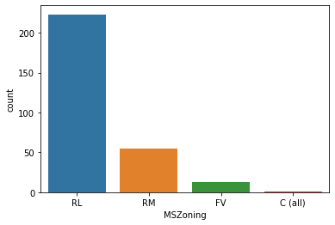
RL 223 RM 55 FV 13 C (all) 1 Name: MSZoning, dtype: int64
ax = sns.countplot(x="MSZoning",data=df_visualization_nominal)
print(df_visualization_nominal["MSZoning"].value_counts())
Here countplot contains the data visualization of nominal columns of MSZoning

Slide 6
Data Visualization
Data visualization is the graphical representation of information and data. By
using visual elements like charts, graphs, and maps, data visualization tools provide an
accessible way to see and understand trends, outliers, and patterns in data. In the
world of Big Data, data visualization tools and technologies are essential to analyze
massive amounts of information and make data-driven decisions.

Slide 7
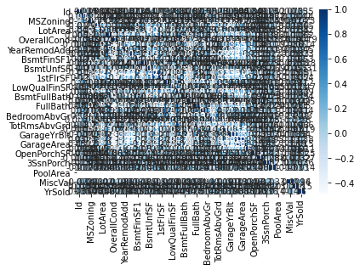
<
plt.figure(figsize=(6,4))
sns.heatmap(dfcor,cmap='Blues',annot=True)

Slide 8
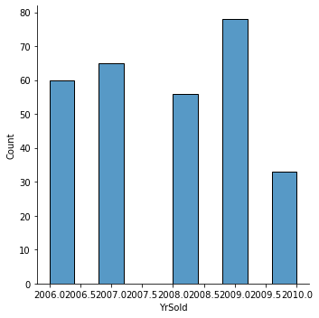
sns.displot(df['YrSold'])

Slide 9
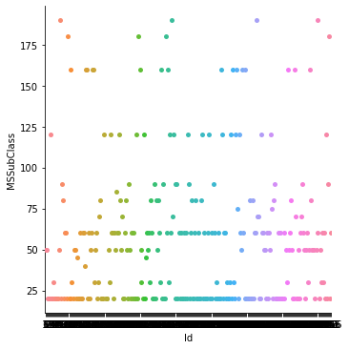
df_visualization_ordinal=df[["Id","MSSubClass"]].copy()

Slide 10
Pre-processing pipeline:
For the model to proceed with the data efficiently, the categorical variables
salary and department have been encoded. As the values of salary have an order, they have been encoded
into integers within the same variable. For department, as the values have no specific order, they have been
encoded into individual variables with Boolean values. Thus, the dataset has been transformed from 10variables to 19 variables. Numerical variables scaled between 0 and 1 to remove any influence of their difference in value ranges on the model. They have also been checked for skewness, without a real change on their shape.

Slide 11
Building machine learning model:
As the dataset is imbalance, use cross validation when training the models, and each baseline model performance can be tabulated.
The model will be cross-validated using a 10-fold cross validation method returning the average accuracy. This method will be applied at every modelling step, to ensure that the model is not biased by the training set split

Slide 12
According to the classification report the accuracy of the model is 74% however its recall is lower at 43% of positive
cases. The RandomForestRegressor is providing excellent results, however the purpose of the problem is to
identify employees that are likely to leave. This is the reason that recall then becomes a very important measure.
Recall measures the fraction of values that are identified correctly. Random Forest Classifier has emerged as the final
winning model with F1-score 100.0% and highest Recall 100.0%. This could be the highest possible score achieved
with the inherent limitations in the dataset.

Slide 13
Machine learning models are as good as the data to feed it, and more data would strengthen the model. For example, in this dataset, the feature ‘Performance Rating’ has been restricted to scores of 3 and 4 only. More insights could be generated if the full spectrum of performance ratings is included. In the real-life situation, getting the right data is often more challenging than the analytics itself.

Slide 14
A Random Forest is an ensemble technique capable of performing both regression and
classification tasks with the use of multiple decision trees and a technique
called Bootstrap Aggregation, commonly known as bagging
Bagging, in the Random Forest method, involves training each decision tree on a
different data sample where sampling is done with replacement.
The basic idea behind this is to combine multiple decision trees in determining the
final output rather than relying on individual decision trees

Slide 15
CONCLUSION
The type of recommendation engine built in this study is called content-based filtering because it uses only intrinsic and spatial features engineered for prediction. This type of recommendation needs a training set that would be too large to generate manually.
In practice, another type of recommendation engine—community-based filtering—is employed. It uses the features engineered for the properties, combined with favorite and blacklist data, to find similarity between a large number of buyers. It then pools the training set from similar buyers to create a large training set.

